Slide 1

Crime Type Prediction Presentation to the Toronto Police Services Board
Analytics & Innovation Unit
Yuko Kurokawa

Slide 2



Agenda
1
Executive Summary
2
Project
-Overview/Assumptions/Limitations
3
Dataset Information
-Data Source/Crime Types-
4
Modeling
-Concept/Example/Model Details-
5
Action

Slide 3
B
Executive Summary
Toronto = The fastest growing city
Tremendous population growth
More robust & immediate responses required
Especially for ‘Emergency’
The need for
Crime Type Prediction System
Safer city
Notes:
Background
Crime has adversely affected people and their society
Toronto is the fastest-growing city in North America
Its population has been tremendously grown
Toronto Police Service requires more robust responses to serve community safety
(There is a situation that a 911 dispatcher can be unsure of the crime type when the caller unable to describe what is happening, and a police officer cannot clarify the crime type when they hear a call for help.)
Especially, in the case of emergency, life and death depend on even a seconds-delay in response
Problem
they need to know the crime tendency in the city and most probable crime type corresponding to corelated features, such as location, time, and premise information.
Solution
Provide a crime type prediction model
Machine learning has been applied in police decision making and optimization in many countries, and Toronto Police Service also has engaged in it and shared open data source regarding crimes.

Slide 4
Project
-Overview-
Project Name | Policing Response Optimization
Objective | Development and Operations of Crime Prediction System
Team | Analytics & Innovation Unit
Cost | $95,000 (For 5 years) Reference from https://www.phdata.io/blog/what-is-the-cost-to-deploy-and-maintain-a-machine-learning-model/
Notes:
Project name
Objective
Team
Time schedule

Slide 5

Project
-Assumptions & Limitations-
The dataset with current status quo for crimes and life style
The data collected between 2014-2021
Crime occurrence has a certain tendency
Data collection was precise
Notes:
Project name
Objective
Team
Time schedule

Slide 6





Dataset Information
-Data Source-
Source | Major Crime Indicator (https://data.torontopolice.on.ca/search?q=crime)
Range | 2014/01/01 – 2021/12/31
Size | 281,692 rows (273,819 rows)
Target | MCI = Crime Types Assault Break & Enter Auto Theft Robbery Theft Over
Inputs | Longitude, Latitude, Premise Type, Month, Day, Day of Week, Hour
Notes:
Introduce a dataset which was used for creating a prediction model
Data Source
Range
Target
Inputs

Slide 7
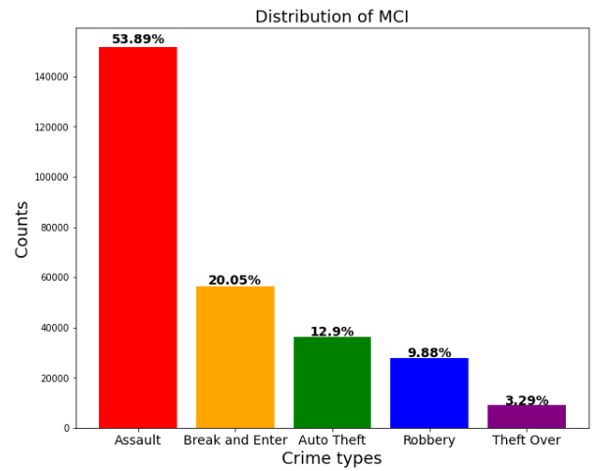
Dataset Information
-MCI(Crime Types)-
Notes:
Introduce a dataset which was used for creating a prediction model
Data Source
Range
Target
Inputs

Slide 8
Dataset Information
-Data Source-
Source | Major Crime Indicator (https://data.torontopolice.on.ca/search?q=crime)
Range | 2014/01/01 – 2021/12/31
Size | 281,692 rows (273,819 rows)
Target | MCI = Crime Types Assault Break & Enter Auto Theft Robbery Theft Over
Inputs | Longitude, Latitude, Premise Type, Month, Day, Day of Week, Hour
Notes:
Introduce a dataset which was used for creating a prediction model
Data Source
Range
Target
Inputs

Slide 9
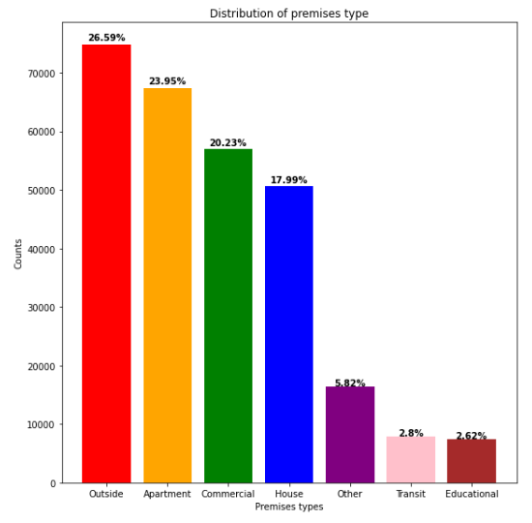
-Premise Type-
Notes:
Introduce a dataset which was used for creating a prediction model
Data Source
Range
Target
Inputs

Slide 10
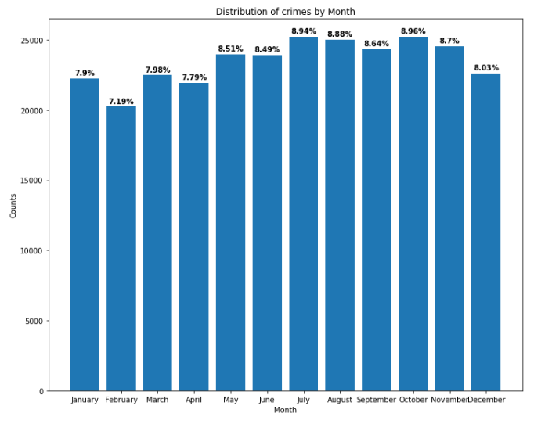
-Month-
Notes:
Introduce a dataset which was used for creating a prediction model
Data Source
Range
Target
Inputs

Slide 11
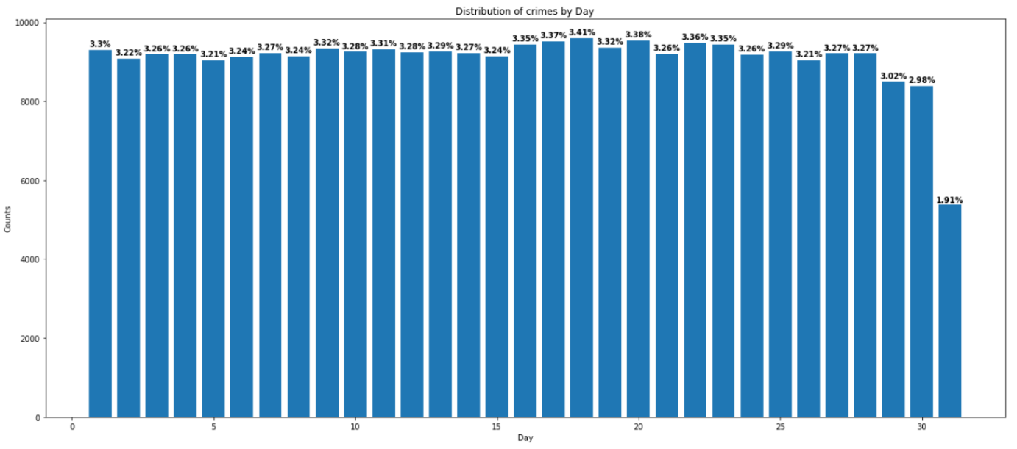
-Day-
Notes:
Introduce a dataset which was used for creating a prediction model
Data Source
Range
Target
Inputs

Slide 12
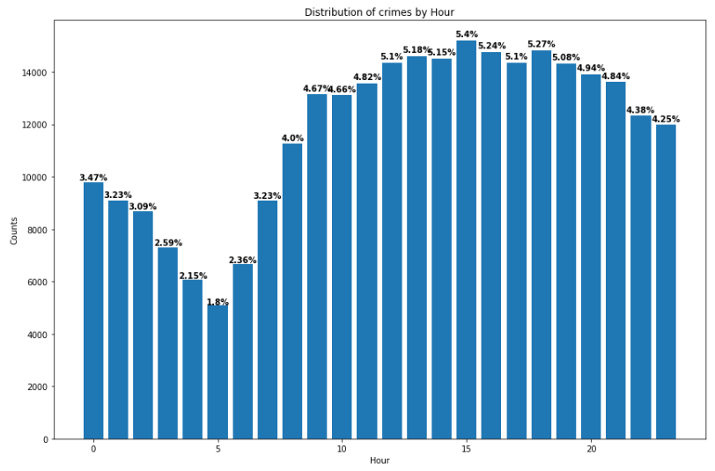
-Hour-
Notes:
Introduce a dataset which was used for creating a prediction model
Data Source
Range
Target
Inputs

Slide 13
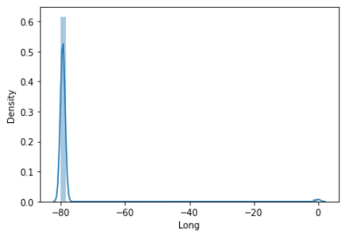
-Longitude-
Notes:
Introduce a dataset which was used for creating a prediction model
Data Source
Range
Target
Inputs

Slide 14
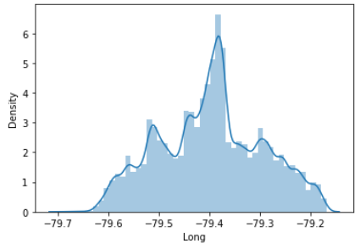
-Longitude(After)-
Notes:
Introduce a dataset which was used for creating a prediction model
Data Source
Range
Target
Inputs

Slide 15
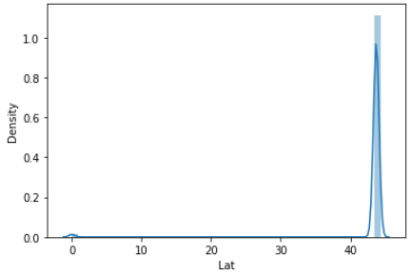
-Latitude-
Notes:
Introduce a dataset which was used for creating a prediction model
Data Source
Range
Target
Inputs

Slide 16
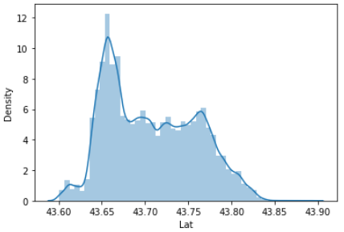
-Latitude(After)-
Notes:
Introduce a dataset which was used for creating a prediction model
Data Source
Range
Target
Inputs

Slide 17

Modeling
-Concept-
Call For Help!
Longitude, Latitude, Premise Type, Month, Day, Day of Week, Hour
Input!
Model
Predicted Crime Type

Slide 18

Modeling
-Example-
Call For Help!
Longitude[-79.616890], Latitude[43.723754], Premise Type[Outside], Month[January], Day[12th], Day of Week[Sunday], Hour[10pm]
Input!
Model

Slide 19
Modeling
-Model Details-
Model Technique: Random Forest
Popular machine learning algorithm using multiple decision trees Takes the majority vote for classification More robust for new data
Model Accuracy: 64.88%
Not very high but more than 60% Reason: 5 classes / Relatively small dataset
Top 3 Important conditions
①Premise type / ②Longitude / ③Latitude
Notes:
Technique Random Forest
Accuracy 64.88%
Important Variables

Slide 20



More
Actions
Recommendation
Model
Deploy Crime Type Prediction System
Advantage
Optimize emergency responses
by 911 dispatchers and police officers
Benefit
More safety to the city of Toronto
Notes:
Deploy this crime type prediction model

Slide 21
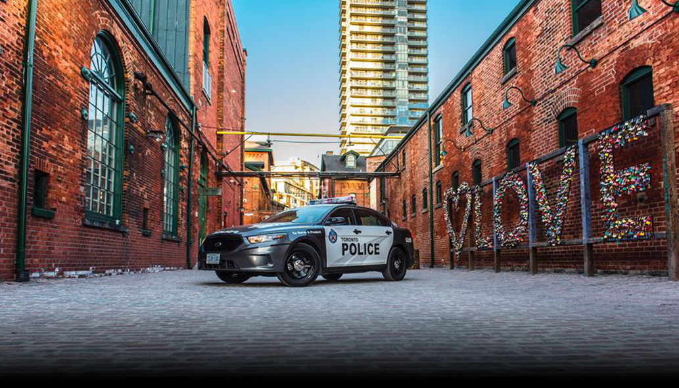
Thank you so much

Slide 22
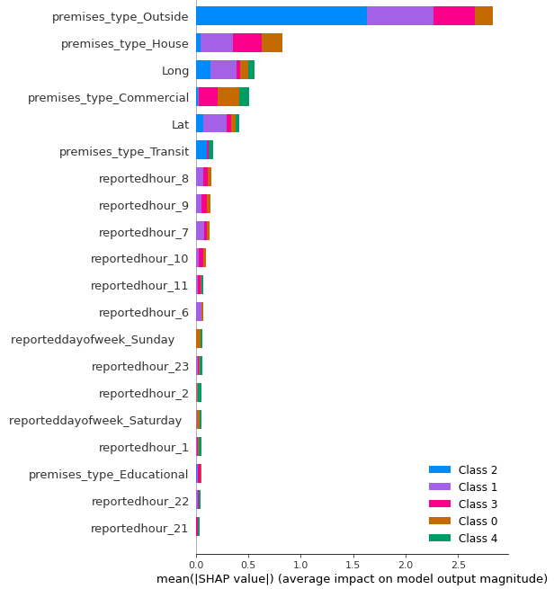
Appendix -Important Features-
Notes:
Introduce a dataset which was used for creating a prediction model
Data Source
Range
Target
Inputs

